Slide 1






Exploring the Relationship Between
Learning Styles and Academic Achievement
Wei Meng Xi 58593147
HEKAHUNG 57824104

Slide 2

Purpose
Explore how different learning styles influence academic achievement
e.g. Duration of study per day, study during the day or
or at night?
Identify effective learning methods to enhance student performance
Predict student performance with reasonable accuracy.

Slide 3



Data Source
From Kaggle by lainguyn123
Data Source:
https://www.kaggle.com/datasets/lainguyn123/student-performance-factors/data

Slide 4




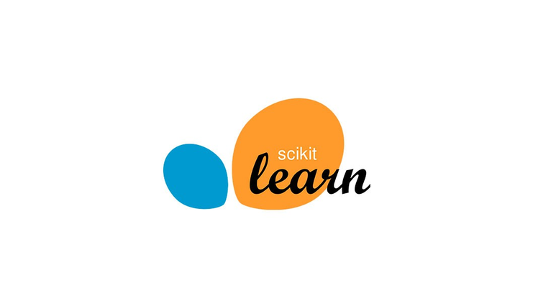
Technological Tools
numpy
Pandas
SciPy
Matplotlib
Scikit-learn
Python third-party library

Slide 5
Analysis part
Data visualization
Pearson Correlation
Prediction part
KNN
Random forest
Deep learning
Methodology

Slide 6
Plan
WEEK
WEEK
WEEK
WEEK
WEEK
6
7
9
8
11
Determine the topic
Find the Datasets
analysing data
Working on the Report
Prepare for Presentation

Slide 7
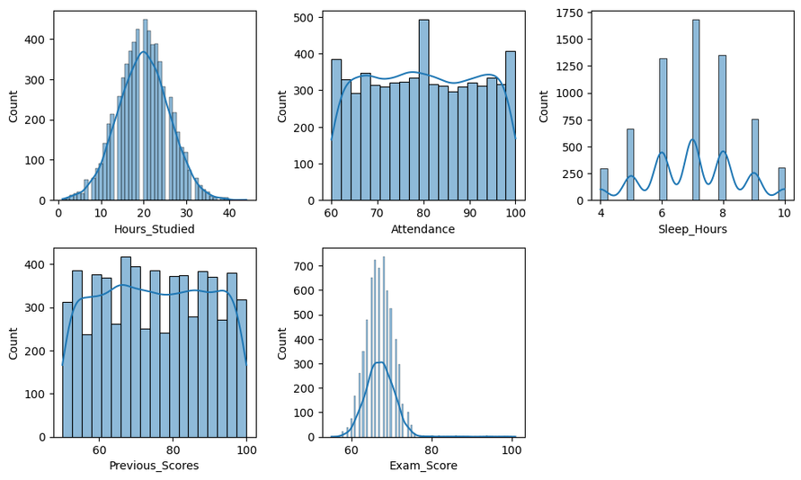
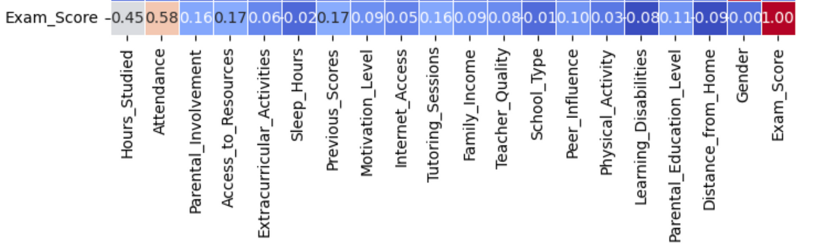
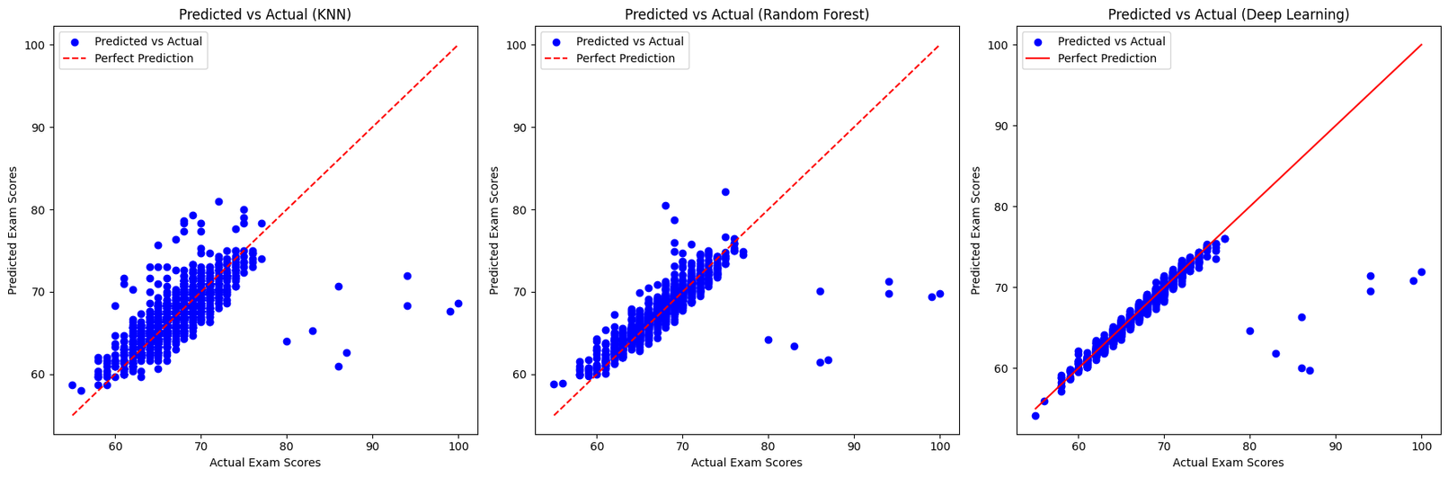
Works that has been done

